Slide 1
2.Relational Model
Feb 26, 2025.
SEI.

Slide 2
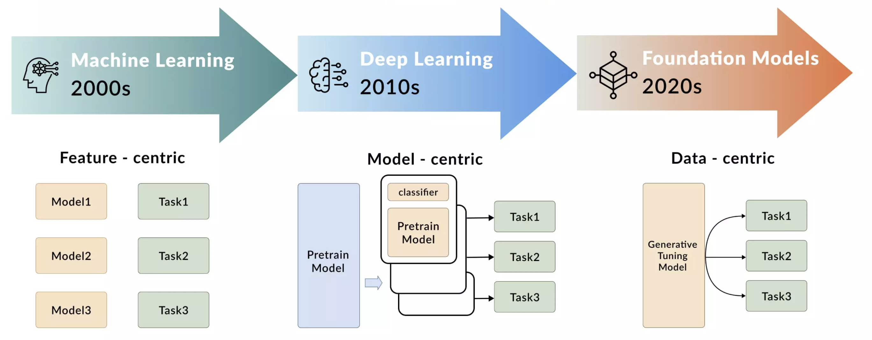
Data Foundation.

Slide 3
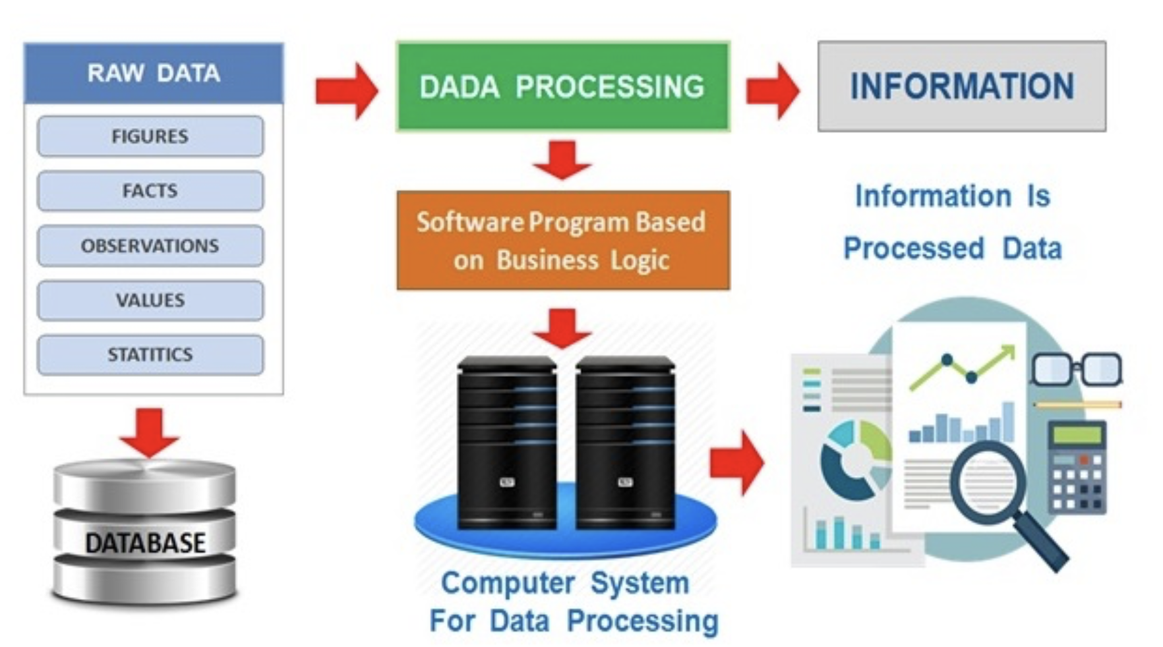
Database.

Slide 4
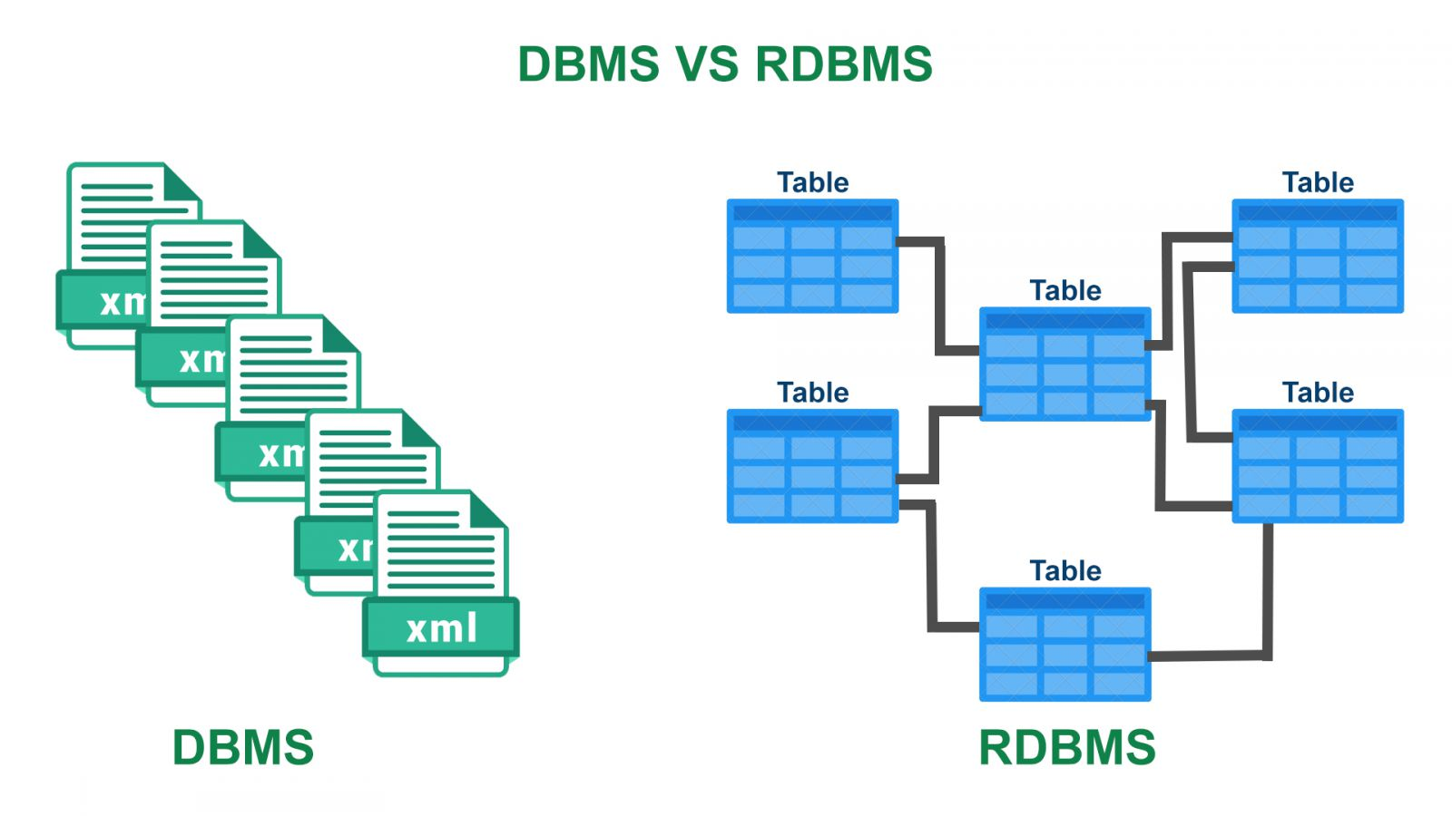

Slide 5
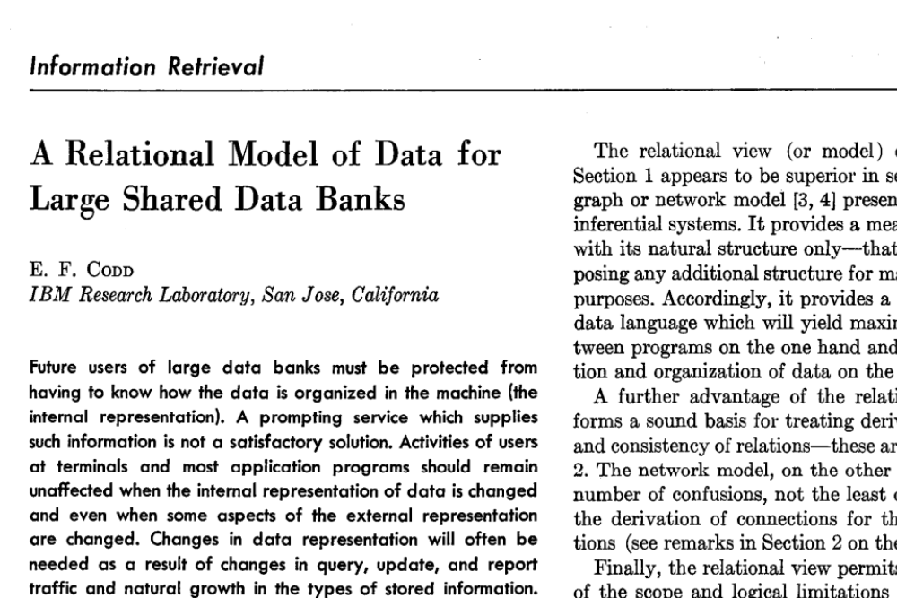
CACM 1970， original paper.

Slide 6
Pioneer work.
• Mathematical Foundation:
Introduced a formal, set-based approach to databases.
• Relational Operations:
Established algebraic operations like selection, projection, and joins.
• Data Independence:
Separated logical structure from physical storage, enabling flexibility.
• Normalization:
Defined rules to eliminate redundancy and improve consistency.
• Influence on SQL: Provided the theoretical basis for modern relational databases and query languages.

Slide 7
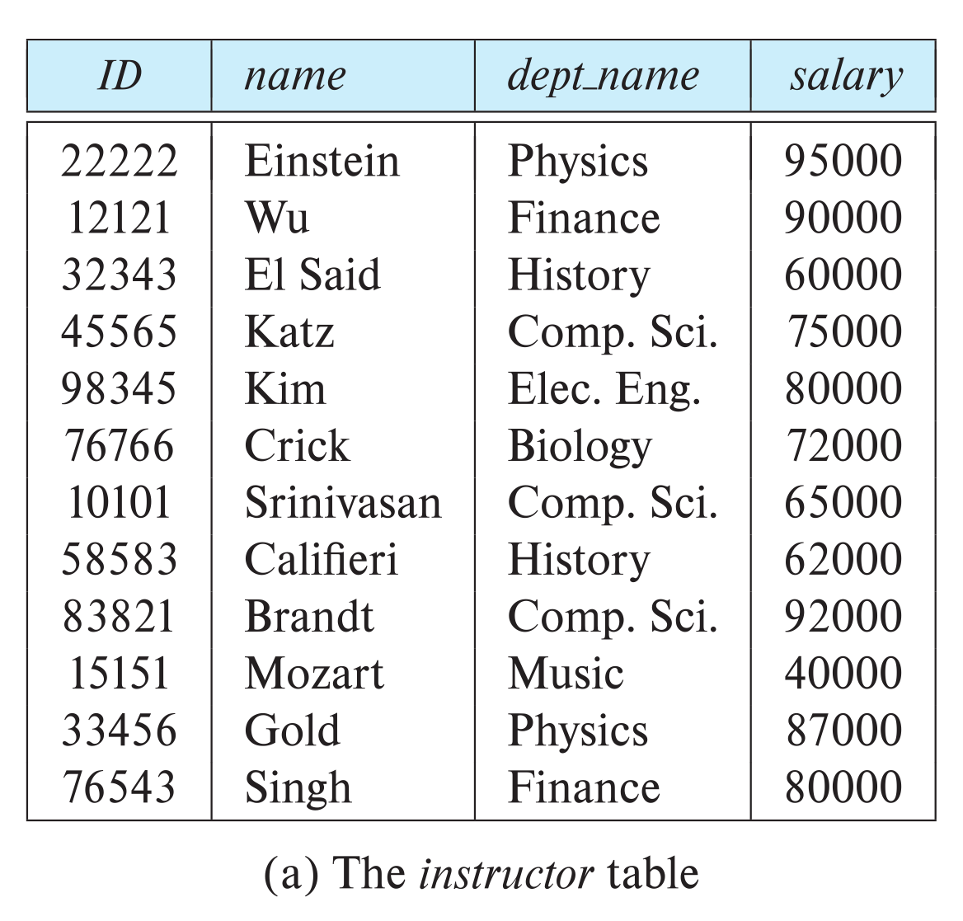

Relational Model
A relation is unordered set that contain the relationship of attributes that represent entities
A tuple is a set of attribute values in the relation.
Values are (normally) atomic/scalar.
The special value NULL is a member of every domain
Columns
Rows
Ted Codd Turing Award 1981
n-ary Relation = Table with n columns

Slide 8
Schema and Instance
A₁, A₂, …, A_{n} are attributes
R = (A₁, A₂, …, A_{n} ) is a relation schema
Example:
instructor = (ID, name, dept_name, salary)
A relation instance r defined over schema R is denoted by r(R).
The current values a relation are specified by a table
An element t of relation r is called a tuple and is represented by a row in a table

Slide 9
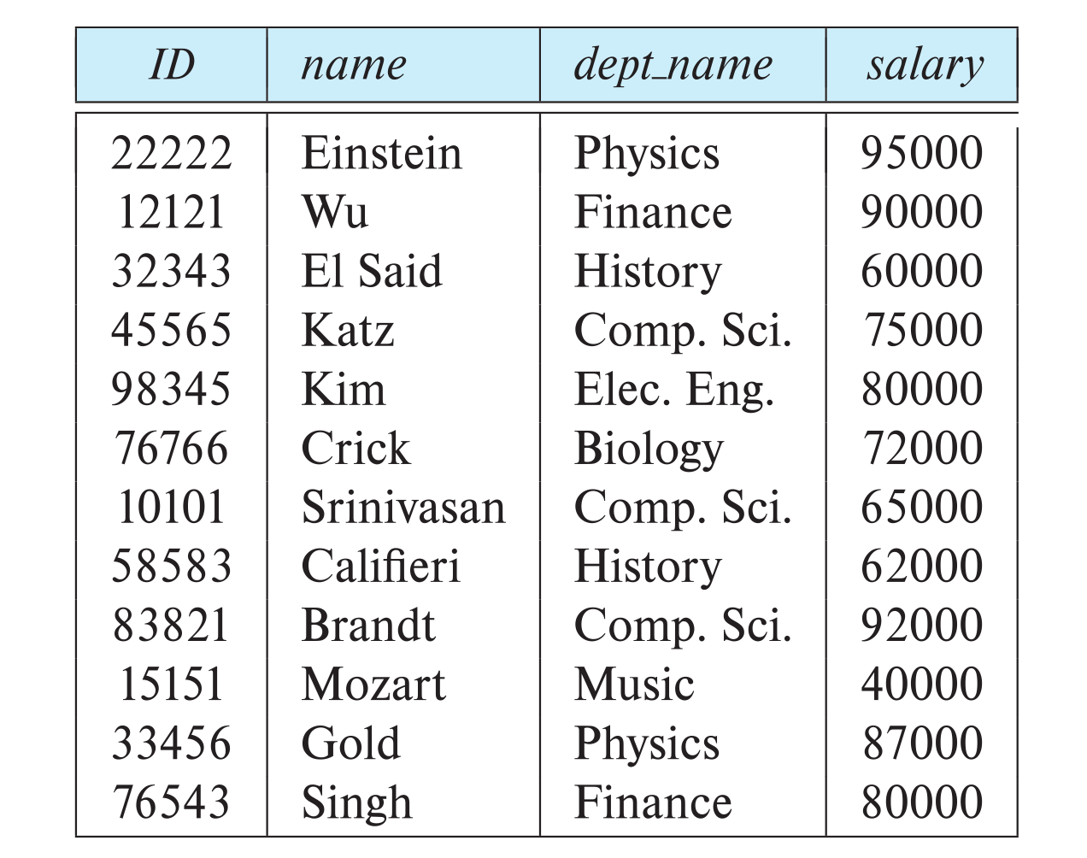
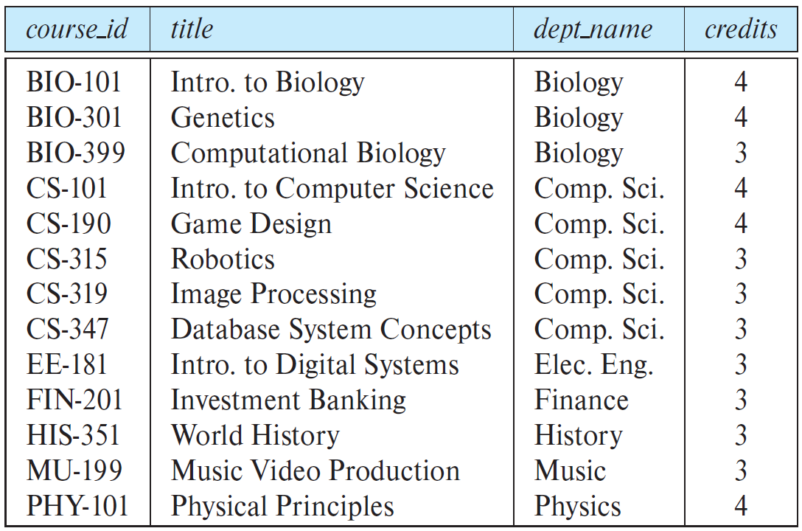
Examples
Instructor (ID, name, dept_name, salary)
course(course_id, title, dept_name, credits)

Slide 10
Keys
Let K ⊆ R
K is a superkey of R if values for K are sufficient to identify a unique tuple of each possible relation r(R)
Superkey K is a candidate key if K is minimal
One of the candidate keys is selected to be the primary key.
Foreign key constraint: Value in one relation must appear in another
Referencing relation
Referenced relation

Slide 11
Primary Key
A relation's primary key uniquely identifies a single tuple
Some DBMSs automatically create an internal primary key if a table does not define one
SEQUENCE (SQL:2003)
AUTO_INCREMENT (MySQL)

Slide 12
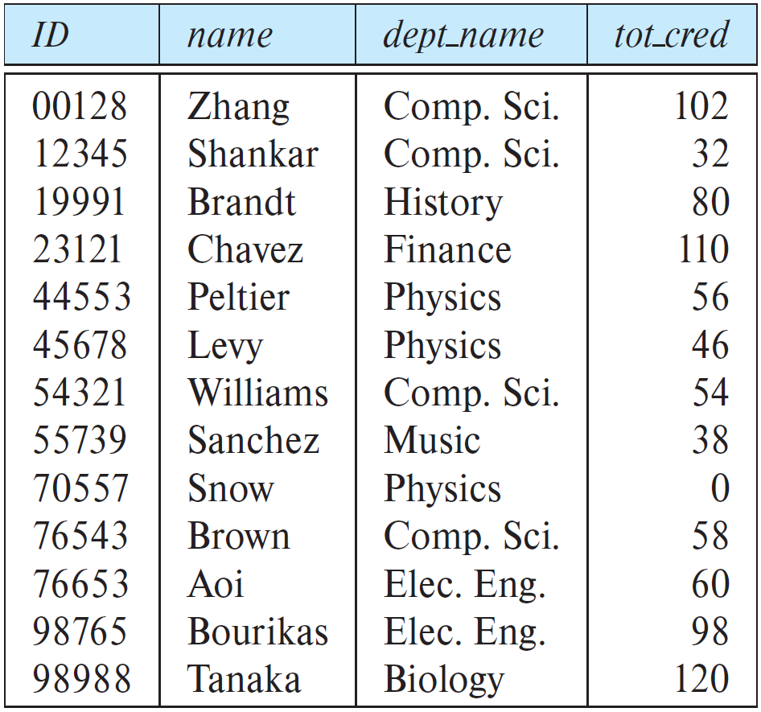
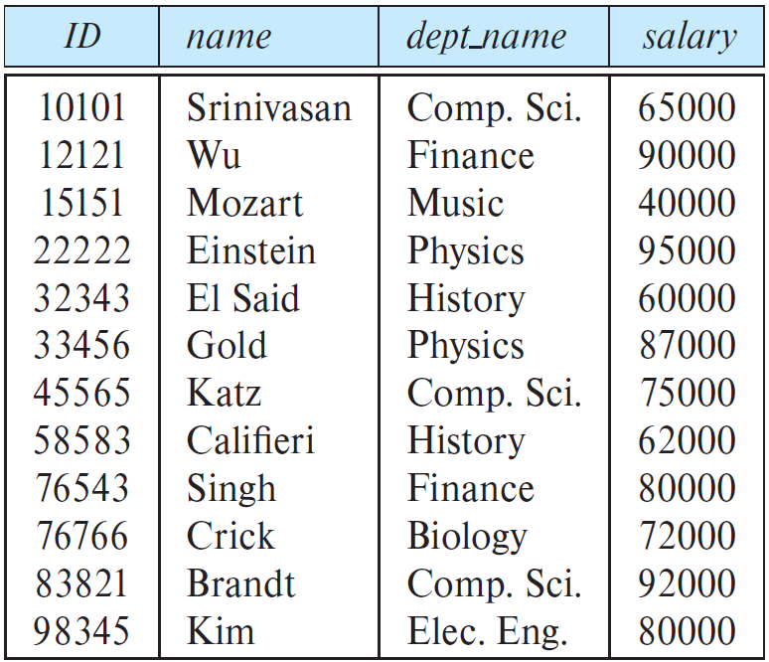
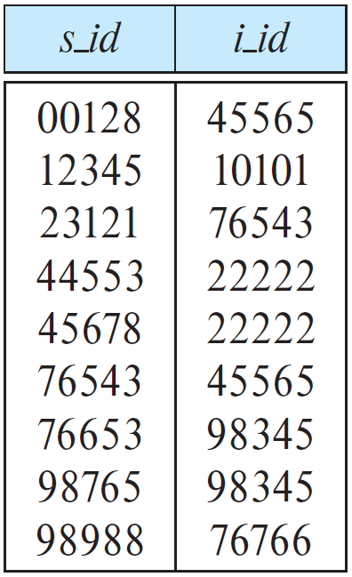
Foreign Key
Student(ID, name, dept_name, tot_cred)
Advisor(s_ID, i_ID)
Instructor (ID, name, dept_name, salary)

Slide 13
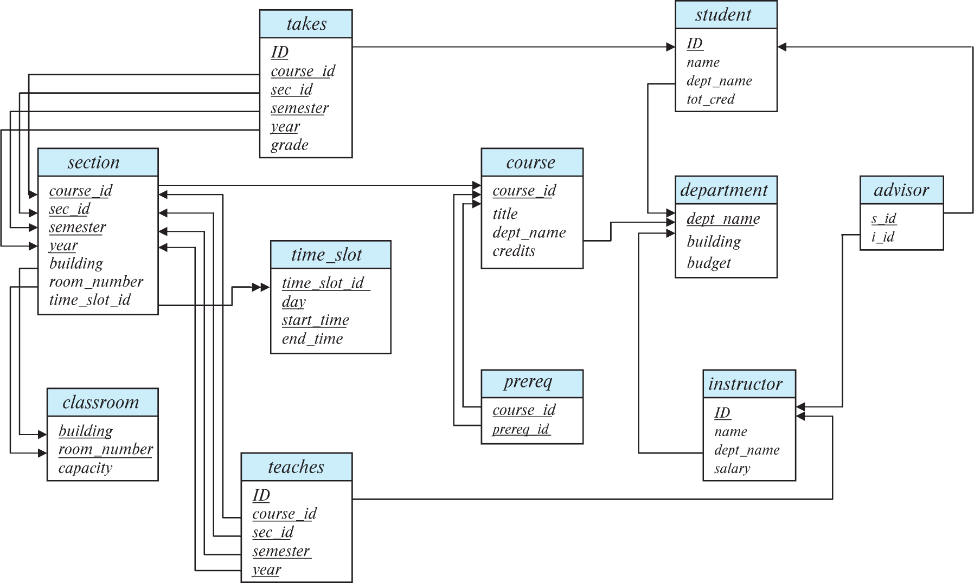
Schema Diagram

Slide 14
Relational Query Languages
Methods to store and retrieve information from a database
Procedural
The query specifies the (high-level) strategy the DBMS should use to find the desired result
Relational Algebra
Non-Procedural
The query specifies only what data is wanted and not how to find it
Relational Calculus
SQL

Slide 15
Relational Algebra
Fundamental operations to retrieve and manipulate tuples in a relation.
Based on set algebra
Each operator takes one or more relations as its inputs and outputs a new relation.
We can "chain" operators together to create more complex operations
Basic Operators
Extra Operators
σ Select
∏ Projection
∪ Union
– Difference
X Product
ρ Rename
∩ Intersection
⋈ Nature Join
← Assignment
÷ Division
τ Sorting
γ Aggregation

Slide 16
Relational Algebra&Calculus
Feature | Relational Algebra | Relational Calculus
Type | Procedural | Declarative
Focus | How to retrieve data | What data to retrieve
Operations | Uses operators like selection, projection, join, etc. | Uses logical predicates
Types | N/A | Tuple Relational Calculus (TRC), Domain Relational Calculus (DRC)
π_{Name}(σ_{Age>30}(Employees))
{ t.Name | Employees(t) ∧ t.Age > 30 }

Slide 17
Relational Calculus
Advantages of Relational Calculus
Higher Abstraction: Relational Calculus enables a user to tell what information is needed but not how it needs to be retrieved which makes it easier to express yourself.
User-Friendly for Non-Experts: This form is easier for the users who may not know the steps that have to be taken when formulating queries.
Disadvantages of Relational Calculus
Less Optimizable: It can be said that this is a disadvantage of the ALG, as being non-procedural, it does not produce definite recommendations to be followed in optimization of a query, which is likely to result in inferior query processing.
Potentially Ambiguous: The abstract nature can at time make it difficult to get the sense of interpretation on the query side and therefore predict results.

Slide 18

Select
Choose a subset of the tuples from a relation that satisfies a selection predicate.
Predicate acts as a filter to retain only tuples that fulfill its qualifying requirement.
Can combine multiple predicates using conjunctions / disjunctions.
r
a_id | b_id
a1 | 101
a2 | 102
a2 | 103
a3 | 104
σa_id='a2’(r)
σa_id='a2'∧b_id>102(r)
a_id | b_id
a2 | 102
a2 | 103
a_id | b_id
a2 | 103

Slide 19
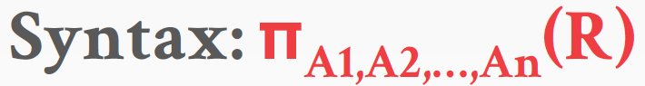
Projection
Generate a relation with tuples that contains only the specified attributes
Can rearrange attributes’ ordering.
Can manipulate the values
Duplicate rows removed from result
r
a_id | b_id
a1 | 101
a2 | 102
a2 | 103
a3 | 104
Πb_id-100,a_id(σa_id='a2’(r))
b_id-100 | a_id
2 | a2
3 | a2

Slide 21

Union
Generate a relation that contains all tuples that appear in either only one or both input relations
r ∪ s
a_id | b_id
a1 | 101
a2 | 102
a3 | 103
a3 | 103
a4 | 104
a5 | 105
r
s
a_id | b_id
a1 | 101
a2 | 102
a3 | 103
a_id | b_id
a3 | 103
a4 | 104
a5 | 105

Slide 22

Difference
Generate a relation that contains only the tuples that appear in the first and not the second of the input relations
r
s
r - s
a_id | b_id
a1 | 101
a2 | 102
a3 | 103
a_id | b_id
a3 | 103
a4 | 104
a5 | 105
a_id | b_id
a1 | 101
a2 | 102

Slide 23

Product
Generate a relation that contains all possible combinations of tuples from the input relations
r × s
r.a_id | r.b_id | s.a_id | s.b_id
a1 | 101 | a3 | 103
a1 | 101 | a4 | 104
a1 | 101 | a5 | 105
a2 | 102 | a3 | 103
a2 | 102 | a4 | 104
a2 | 102 | a5 | 105
a3 | 103 | a3 | 103
a3 | 103 | a4 | 104
a3 | 103 | a5 | 105
r
s
a_id | b_id
a1 | 101
a2 | 102
a3 | 103
a_id | b_id
a3 | 103
a4 | 104
a5 | 105

Slide 24
Rename
Syntax:( ρ_{x(A1,A2,…,An)} (E) )
Provides a name for the results of relational-algebra expressions
r
a_id | b_id
a1 | 101
a2 | 102
a2 | 103
a3 | 104
Πb_id-100,a_id(σa_id='a2’(r))
ρ_{s(bid,aid)}(Πb_id-100,a_id(σa_id='a2’(r)))
b_id-100 | a_id
2 | a2
3 | a2
bid | aid
2 | a2
3 | a2

Slide 25

Intersection
Generate a relation that contains only the tuples that appear in both of the input relations
r
s
a_id | b_id
a1 | 101
a2 | 102
a3 | 103
r ∩ s
a_id | b_id
a3 | 103
a4 | 104
a5 | 105
a_id | b_id
a3 | 103

Slide 26

Nature Join
Generate a relation that contains all tuples that are a combination of two tuples (one from each input relation) with a common value(s) for one or more attributes.
r
s
r ⋈ s
a_id | b_id | c_id
a1 | 101 | xxx
a2 | 102 | yyy
a3 | 103 | zzz
a_id | b_id | d_id
a3 | 103 | 777
a4 | 104 | 888
a5 | 105 | 999
a_id | b_id | c_id | d_id
a3 | 103 | zzz | 777

Slide 28
Assignment
Assigning a relational-algebra expression to temporary relation variables
A query can be written as a sequential program consisting of a series of assignments
Find all instructor in the “Physics” and “Music” department
Physics ← σ _{dept_name=“Physics”} (instructor)
Music ← σ _{dept_name=“Music”} (instructor)
Result ← Physics ∪ Music

Slide 29
Aggregation
Syntax:( _{(A1,A2,…,An)}γ_{f1,f2,…,fm}(E) )
Allows a function to be computed over the set of values returned by a query
average, sum, min, max, count, …
r
_{a_id}γ_{MIN(b_id),SUM(b_id)}(r)
a_id | b_id
a1 | 101
a2 | 102
a2 | 103
a3 | 104
a3 | 105
a3 | 106
a_id | MIN(b_id) | SUM(b_id)
a1 | 101 | 101
a2 | 102 | 205
a3 | 104 | 315

Slide 30
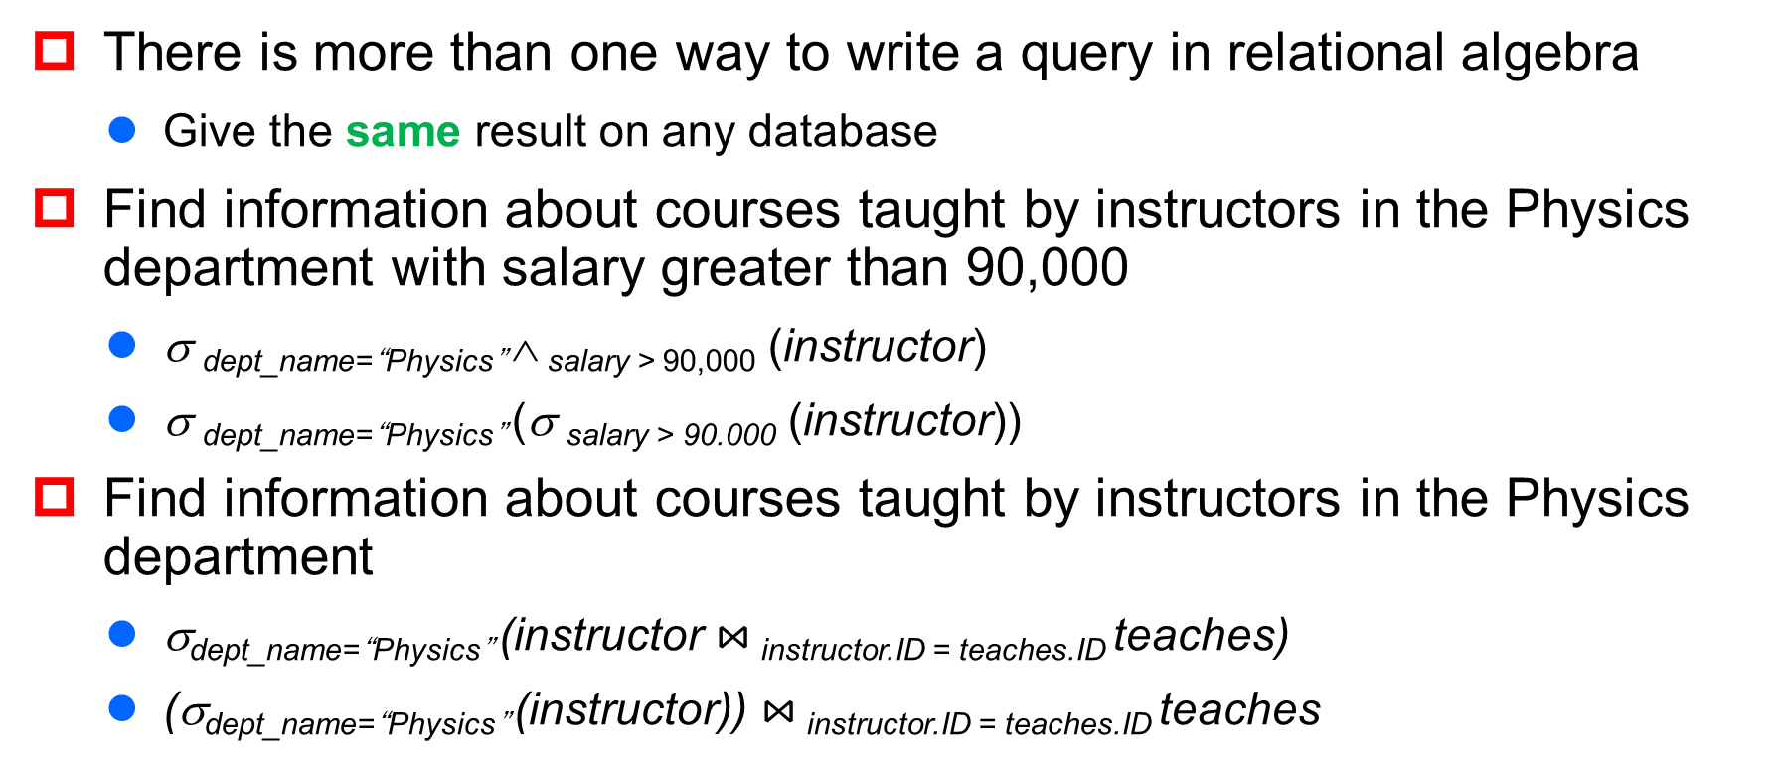
Equivalent Queries
There is more than one way to write a query in relational algebra
Give the same result on any database
Find information about courses taught by instructors in the Physics department with salary greater than 90,000
σ _{dept_name=“Physics”} ∧ _{salary > 90,000} (instructor)
σ _{dept_name=“Physics”} (σ _{salary > 90.000} (instructor))
Find information about courses taught by instructors in the Physics department
σ_{dept_name=“Physics”} (instructor $⋈_{ }$_{instructor.ID = teaches.ID} teaches)
(σ_{dept_name=“Physics”} (instructor)) $⋈_{ }$_{instructor.ID = teaches.ID} teaches

Slide 31
Consider a database with the following schema:
person(name, age, gender)
frequents(name, pizzeria)
eats(name, pizza)
serves(pizzeria, pizza, price)
Find all pizzerias frequented by at least one person under the age of 18.
Find the names of all females who eat either mushroom or pepperoni pizza (or both).
Find the names of all females who eat both mushroom and pepperoni pizza.
Find all pizzerias that serve at least one pizza that Amy eats for less than $10.00.
Find all pizzerias that are frequented by only females or only males.
For each person, find all pizzas the person eats that are not served by any pizzeria the person frequents. Return all such person (name) / pizza pairs.
Find the names of all people who frequent only pizzerias serving at least one pizza they eat.
Find the names of all people who frequent every pizzeria serving at least one pizza they eat.
Find the pizzeria serving the cheapest pepperoni pizza, return all of the cheapest-pepperoni pizzerias.

Slide 32
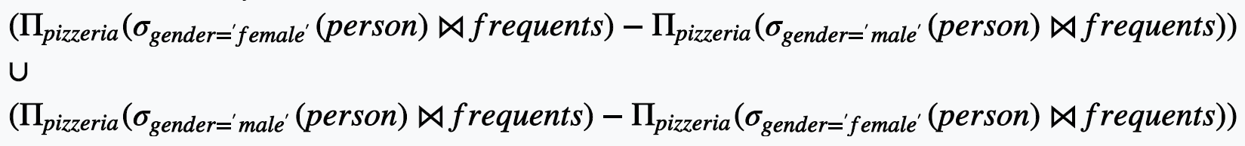
person(name, age, gender)
frequents(name, pizzeria)
eats(name, pizza)
serves(pizzeria, pizza, price)
Find all pizzerias frequented by at least one person under the age of 18.
Find the names of all females who eat either mushroom or pepperoni pizza (or both).
Find the names of all females who eat both mushroom and pepperoni pizza.
Find all pizzerias that serve at least one pizza that Amy eats for less than $10.00.
Find all pizzerias that are frequented by only females or only males.

Slide 33
For each person, find all pizzas the person eats that are not served by any pizzeria the person frequents. Return all such person (name) / pizza pairs.
Find the names of all people who frequent only pizzerias serving at least one pizza they eat.
Find the names of all people who frequent every pizzeria serving at least one pizza they eat.
Find the pizzeria serving the cheapest pepperoni pizza, return all of the cheapest-pepperoni pizzerias.
person(name, age, gender)
frequents(name, pizzeria)
eats(name, pizza)
serves(pizzeria, pizza, price)

Slide 34
Homework 1
2.14, 2.15, 2.18

